Slide 1
Sharp Bank -functionalities presentation-
Roman Valentin Remus
Paraschivescu Maria Cristiana
Batrana Teodor Ioan

Slide 2
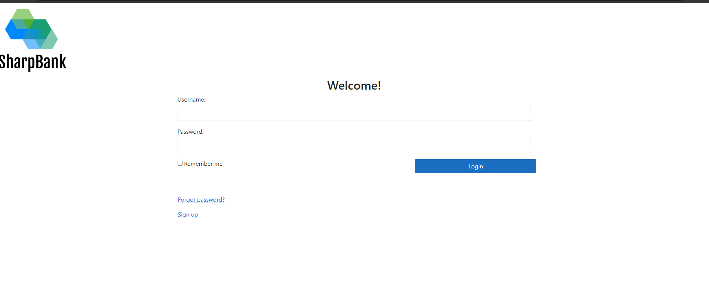
Login Functionality
A customer is now able to login inside the application, receiving a token used for authorization in app usage
There is also future support for adding other authorization policies (e.g. for admin)

Slide 3
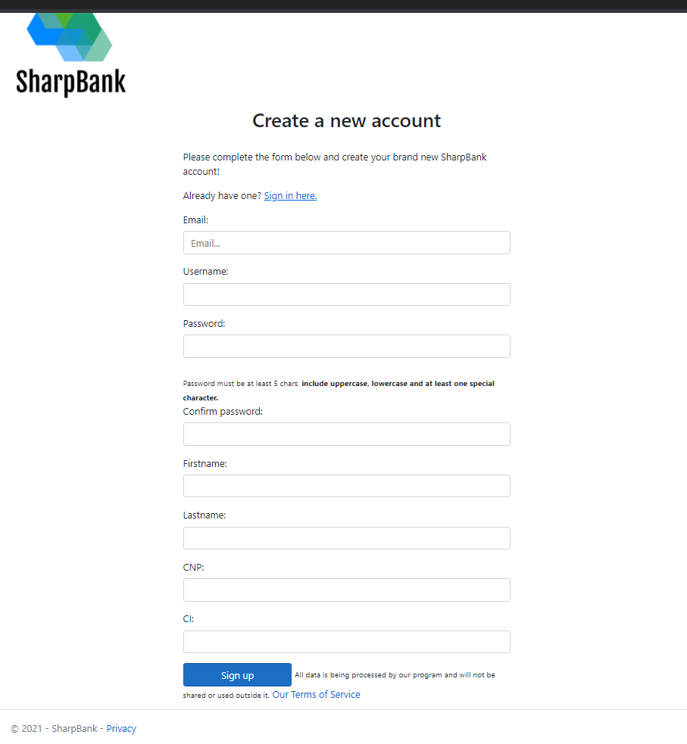
Register Functionality
A customer is now able to register inside the application, receiving a token used for authorization in app usage
There is also future support for adding other authorization policies (e.g. for admin) – the info about the user is provided inside the generated jwt token

Slide 4
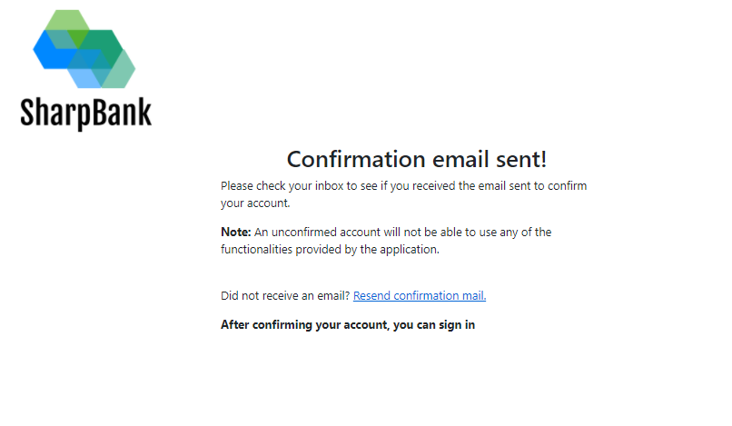
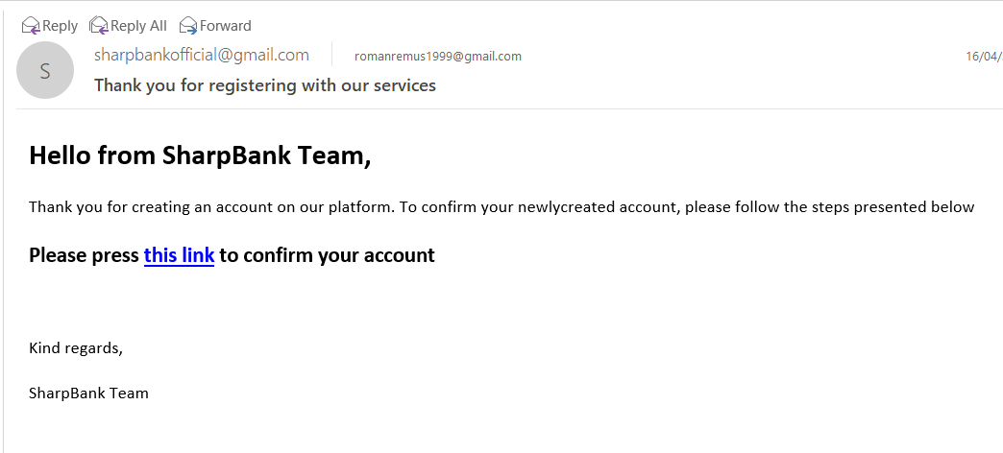
2Factor Signup Confirmation Functionality
When a user logs in, the app automatically sends a confirmation link to the user’s email address and awaits a link navigation(with a unique token) to validate the customer.

Slide 5
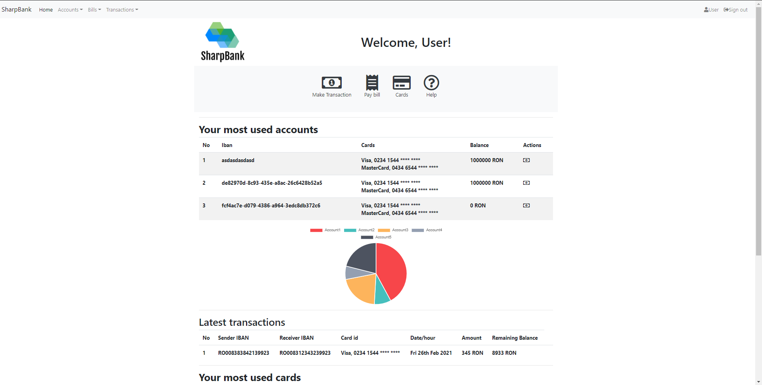
Home page
A user is now able ( after log in) to see his accounts, a pie chart of his account balances and latest transactions

Slide 6
A user also now has quick access to key actions by accessing items in the 2 menues
Also this page support usefull information and quick action buttons, like make transaction

Slide 7
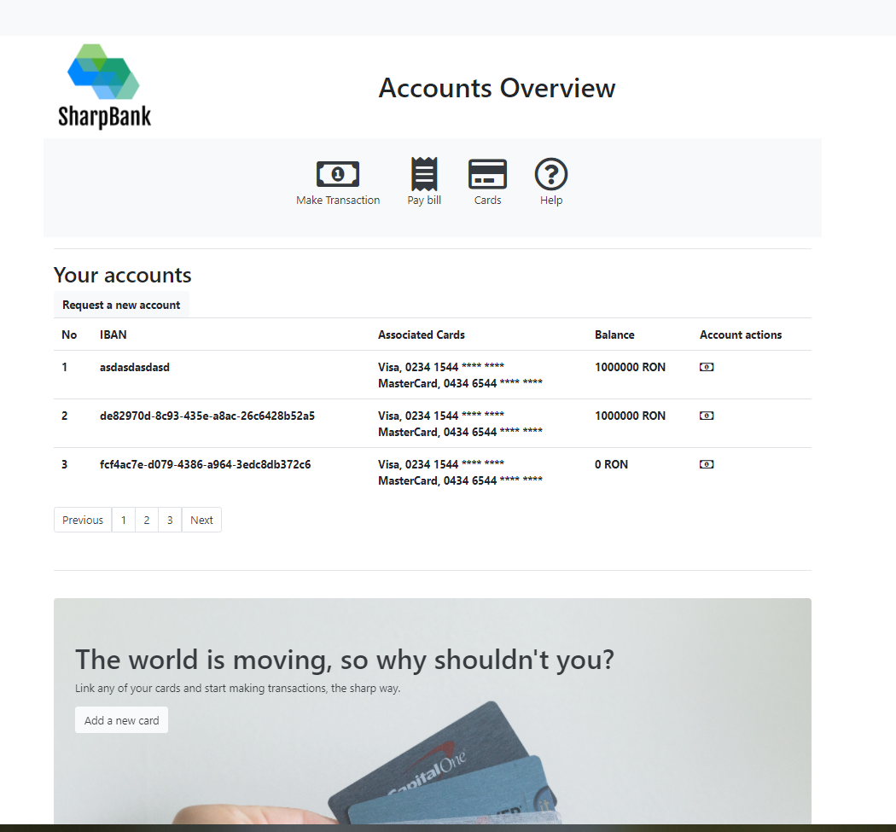
Accounts overview functionality
A user is now able to see all his accounts and balances

Slide 8
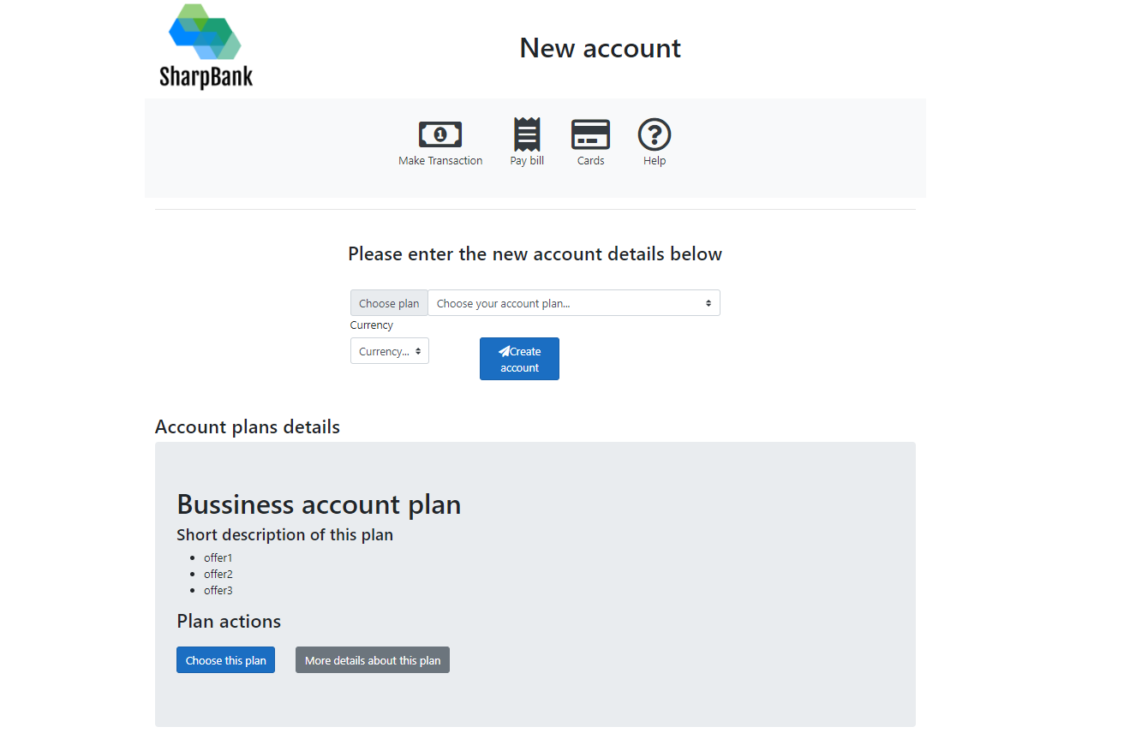
Request account functionality
A user is now able to add an bank account, choosing a preffered account plan and currency
Also a short overview of possible account plans is visible below

Slide 9
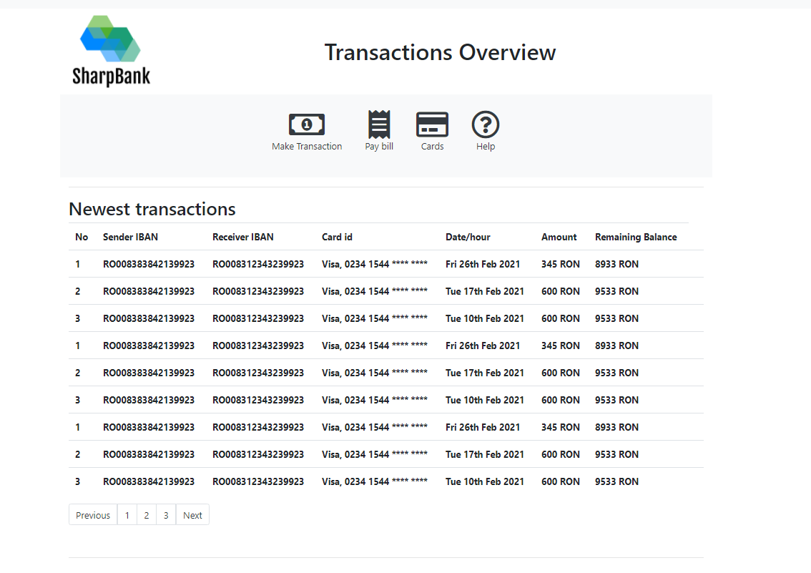
Transactions overview functionality (partially implemented due to unsolved bug in API)
A user is now able to see his transactions ( from all accounts)

Slide 10
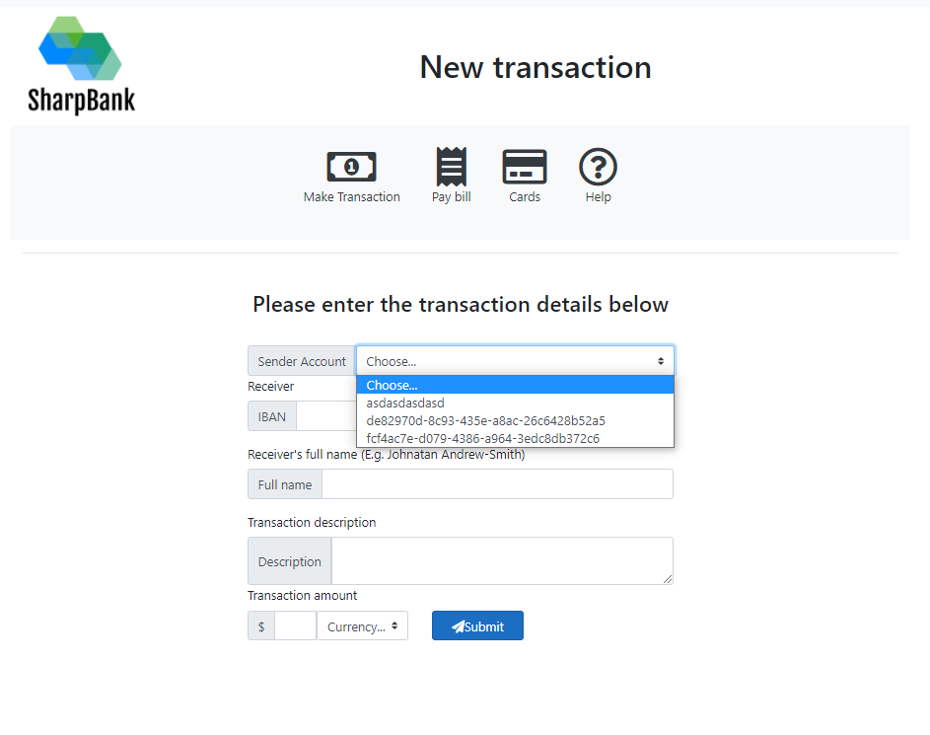
Make transaction functionality (partially implemented due to unsolved bug in API)
A user is now able to make transaction ( from all owned accounts)

